Slide 1
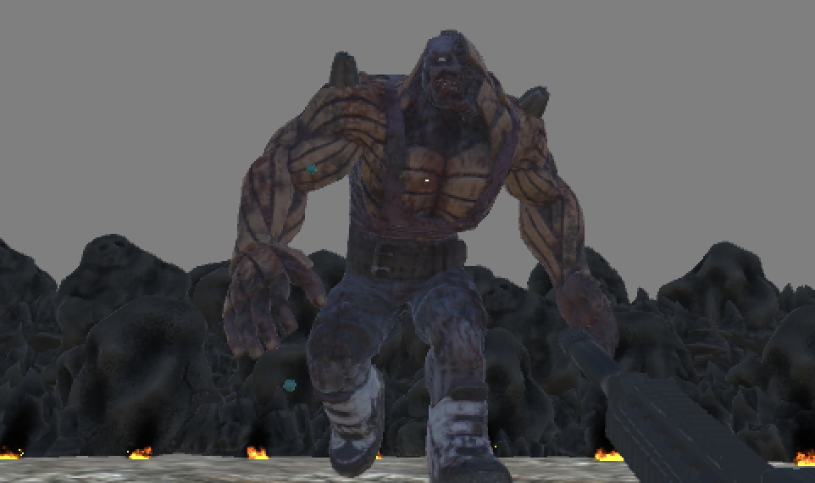

100 Guns
CSE 451 - Final presentation
Jonny Werthman, Andrew Oh, Sam Yoo, Kevin Chen

Slide 2
About the 100 Guns project
First-person FPS shooter, going around the game map, getting a gun after killing enemies, and killing the last boss.

Slide 3

Core Loop
Input
keyboard & mouse
Action
Shooting
Obstacle
Enemy
Goal
Killing all the enemies and collecting guns.

Slide 4
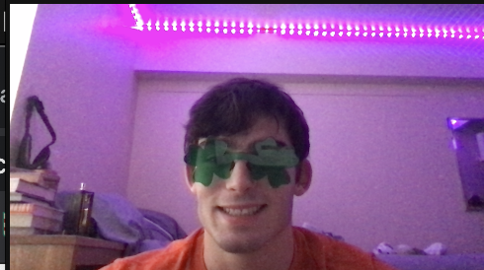
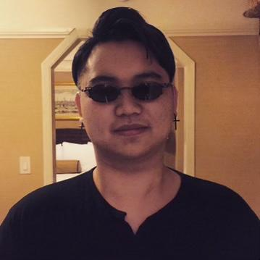
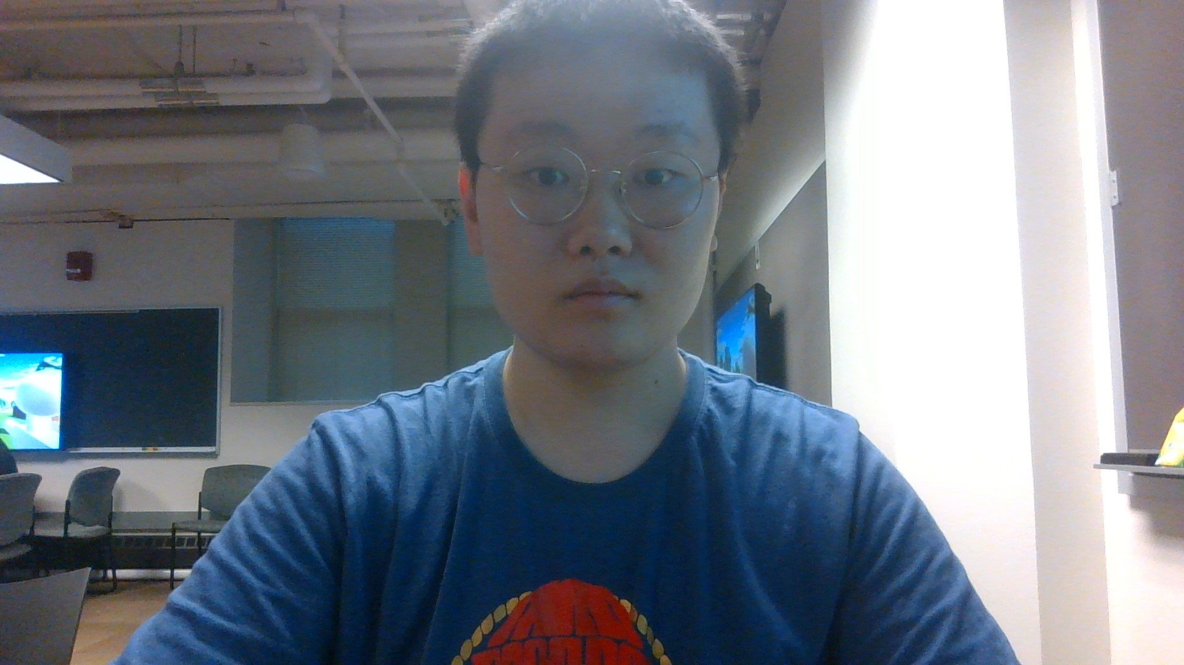
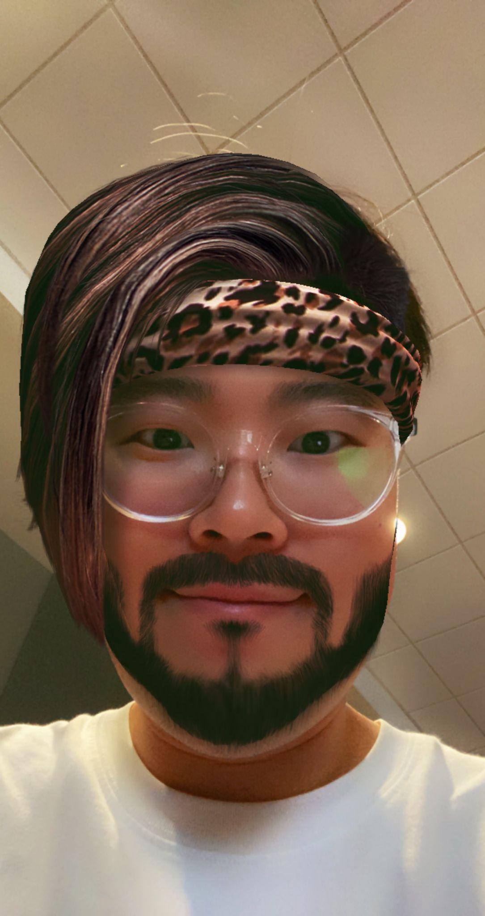
Group Members
Jonny Werthman
Andrew Oh
Kevin Chen
Sam Yoo
Enemies (box, alien, & final boss)
health/damage logic
Main character
Functioning of character
Enemy function
Gun and Bullets Design
UI - backpack, worktable and tutorial
Game Map
Game Menu
Game UI Design

Slide 5
Team Postmortem
Students describe the positives/ negatives of their team production approach
positives
Boost creativity: Teams from diverse backgrounds and experiences can come together to produce new ideas and creative outcomes.
Building a sense of community: Working together on projects allows team members to build a sense of community and improve collaboration skills.
Negatives
Difficult deal with merge conflicts and multiple people trying to push at once. Rather than trying to work on our own branches we stayed on the same branch. We would meet once a week and assign certain days that each person would work on the project and what they would add.

Slide 6
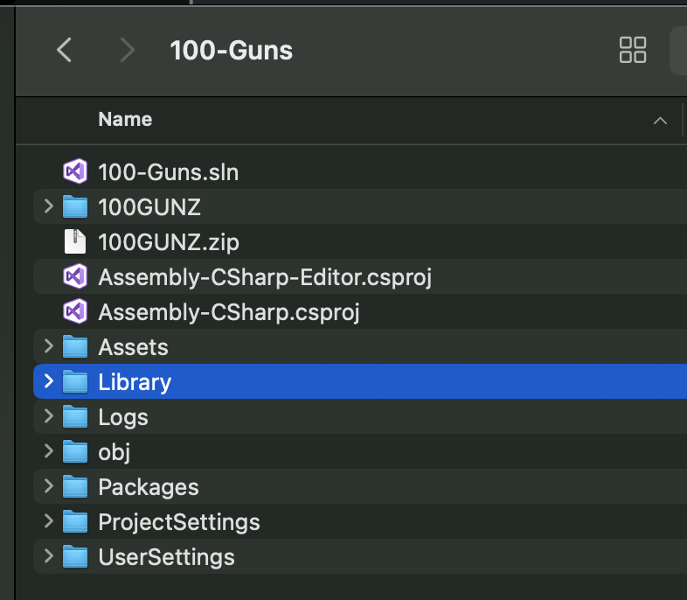

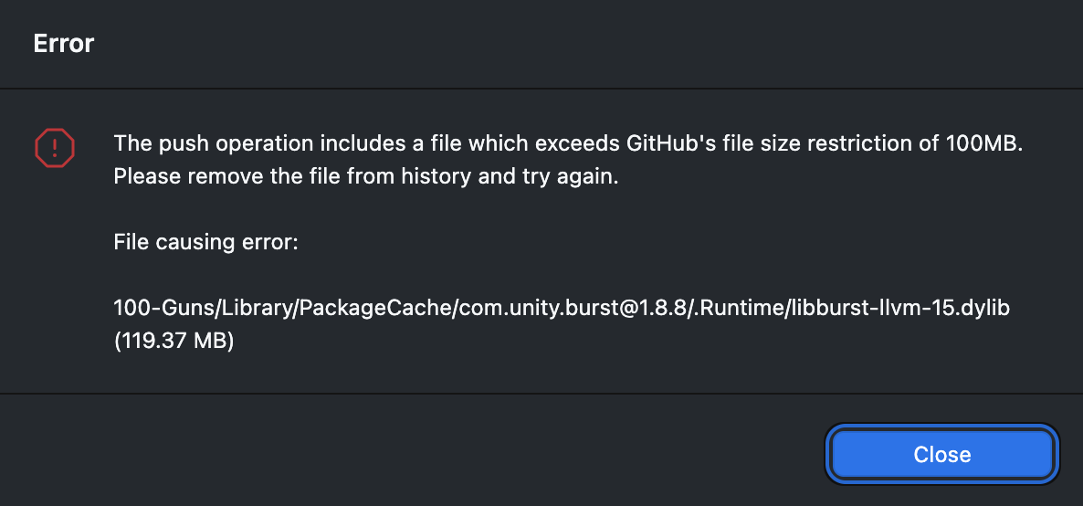

The most difficult errors in the project

Slide 7
Describes successes, failures, and derives clear lesson learned.
Successes
Most people like the FPS game type style. Our game type is FPS game type, and the rules are easy and intuitive, so anyone can enjoy it easily.
Created a map with lots of detail and routes
Created enemies that are fun to shoot and have good AI
Failures
Multiple parts of the game were changed drastically from start to finished including: shooting mechanics.
Game items were lacking. The story and game items of the game were poor, reducing the immersion of the users.
lesson learned
Simplified gameplay is important. The more complex a game is, the more difficult it can be for users. Therefore, it is important to create a simplified gameplay by focusing on the core fun elements of the game.
We should have enough time to 3D game develop. Because 3D games have complex systems, gaming may not be complete unless you have enough time to develop them.

Slide 8
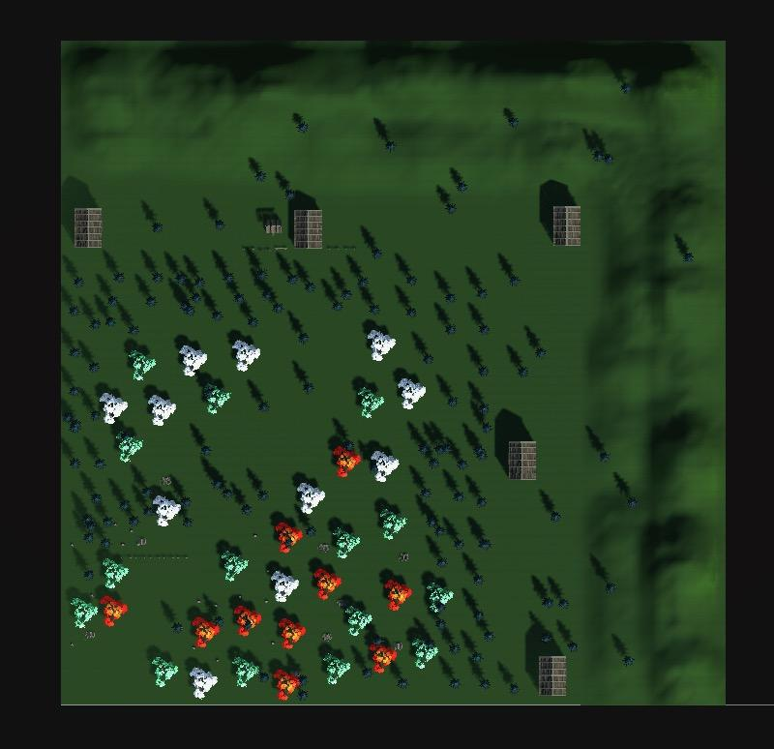
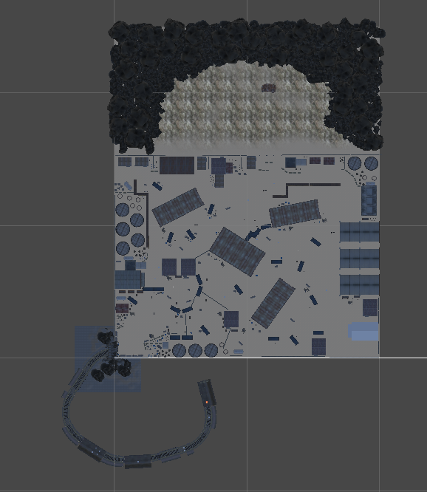
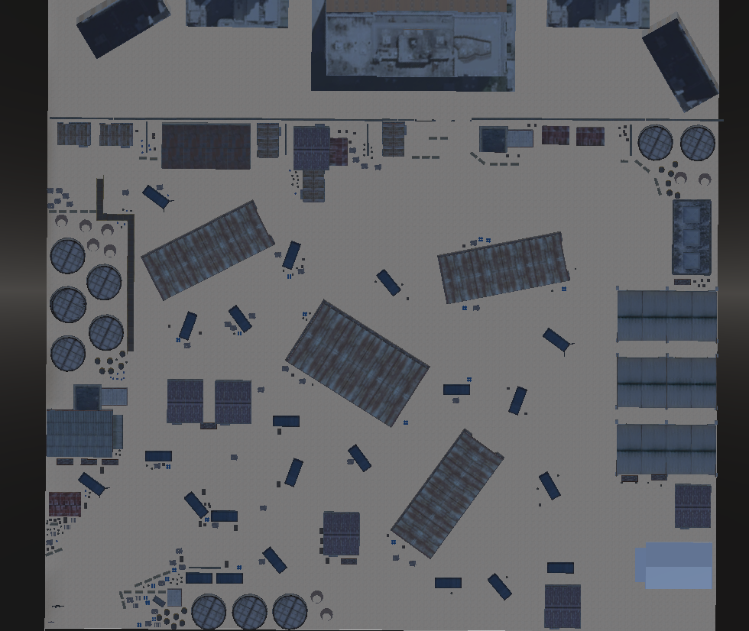
Game map change process

Slide 9
User Feedback and Success
‘Daniel Ryu’ Player Reviews
Game map design and enemy monsters immersed me more when playing the game.
‘Junyeong Jo’ Player Reviews
As a FPS gaming stand, it has various types of action and realistic places for maps with great action of shooting with main character animation.
Matthew Kim
During the game, enemies appeared in the tunnel, and I felt like it was an FPS game. It was impressive to see the enemies shooting at the player.

Slide 10
References
https://assetstore.unity.com/packages/3d/environments/industrial/rpg-fps-game-assets-for-pc-mobile-industrial-set-v3-0-101429
https://assetstore.unity.com/packages/3d/props/guns/guns-pack-low-poly-guns-collection-192553
https://assetstore.unity.com/packages/vfx/particles/fire-explosions/free-fire-vfx-266227
https://assetstore.unity.com/packages/3d/props/guns/machine-guns-20611

Slide 16

User Feedback and Success
‘Daniel Ryu’ Player Reviews
‘Junyeong Jo’ Player Reviews
Game map design and enemy monsters immersed me more when playing the game.
As a FPS gaming stand, it has various types of action and realistic places for maps with great action of shooting with main character animation.
(Name) Player Reviews
(Name) Player Reviews

Slide 17
project record

Slide 18
project record

Slide 19
Coding Function

Slide 20

Mobile Testing

Slide 21
User Feedback and Success
‘Daniel Ryu’ Player Reviews
‘Junyeong Jo’ Player Reviews
Boss characters and interesting enemy monsters immersed me more when playing the game.
As a FPS gaming stand, it has various types of action and realistic places for maps with great action of shooting with main character animation.
(Name) Player Reviews
(Name) Player Reviews

Slide 22
Development Process
1
Concept & Planning
Design & Art Production
2
Thoroughly brainstormed game mechanics, character designs, and storyline to create a unique and engaging zombie survival experience.
Collaborated with a talented team of artists to create realistic environments, compelling characters, and terrifying zombies.
3
Programming & Implementation
Utilized cutting-edge game development technologies to bring the game to life, optimizing performance and ensuring smooth gameplay.
Testing & Bug Fixing
4
Conducted rigorous quality testing, identifying and resolving bugs to ensure a seamless and enjoyable player experience.
5
Release & Updates
Launched the game on various platforms and continue to provide regular updates to enhance gameplay, introduce new content, and address player feedback.

